Slide 1

Jordan Marshall | George Reid | Jakub Pažej | Shane Rousseau | Ayoub Jdair
18256716 | 18259588 | 18260179 | 18224342 | 18266401

Slide 2
Summary of dazed
The game starts in a hospital during a zombie apocalypse. The main character awakes from a coma.
The character escapes the hospital and gets into a car. The main character then goes home to find his daughter and finds out she is not there.
The main character is on a quest to find his daughter during a zombie apocalypse.

Slide 3
features that we could implement into the game
There are many features that we used in the development of the game. Cinco allowed us to use these features:
Timer: this allowed us to use a countdown to place pressure on the player.
Options: the player is given options to decide how the game plays out. The player is also able to interact with the images on the screen. The player is able to choose a selected area to progress in the game.
Inventory: allows the players to get items throughout the gameplay

Slide 4
features that we could not implement into the game
The use of sounds in the game was not able to be implemented into the game. Sound would allow us to create a more realistic game.
Our team could not implement video into the development of the game as the cinco adventure game did not support it.

Slide 5
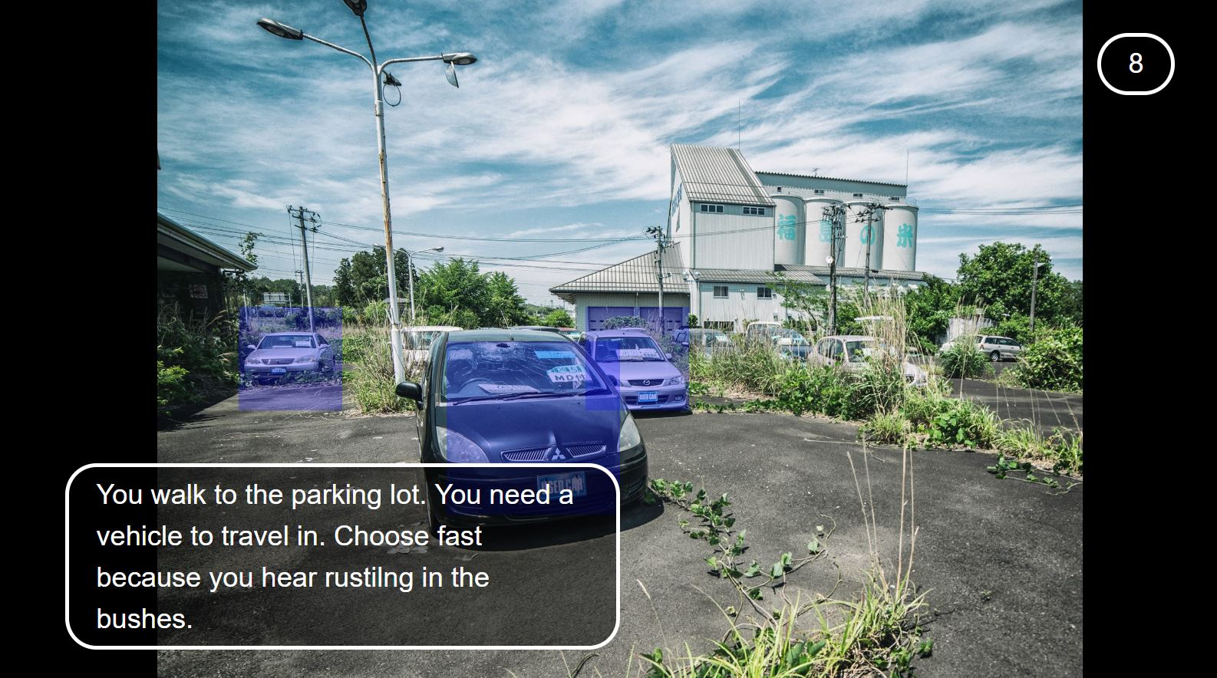
Example of options
The blue boxes allow the player to be able to click on the image and progress in the game. This combined with the timer makes the player make quick decisions.

Slide 6
Images
Some of the images used in the game were custom created using photo editing software. The software we used was paint.net. This allowed us to have control over the type of images used in the game that are more relatable to the story
We were able to use .gif files instead of using the general .png or .jpg files. Gif files allows us to create a more visual environment.
The images used in this game were taken from imgur and giphy.

Slide 7
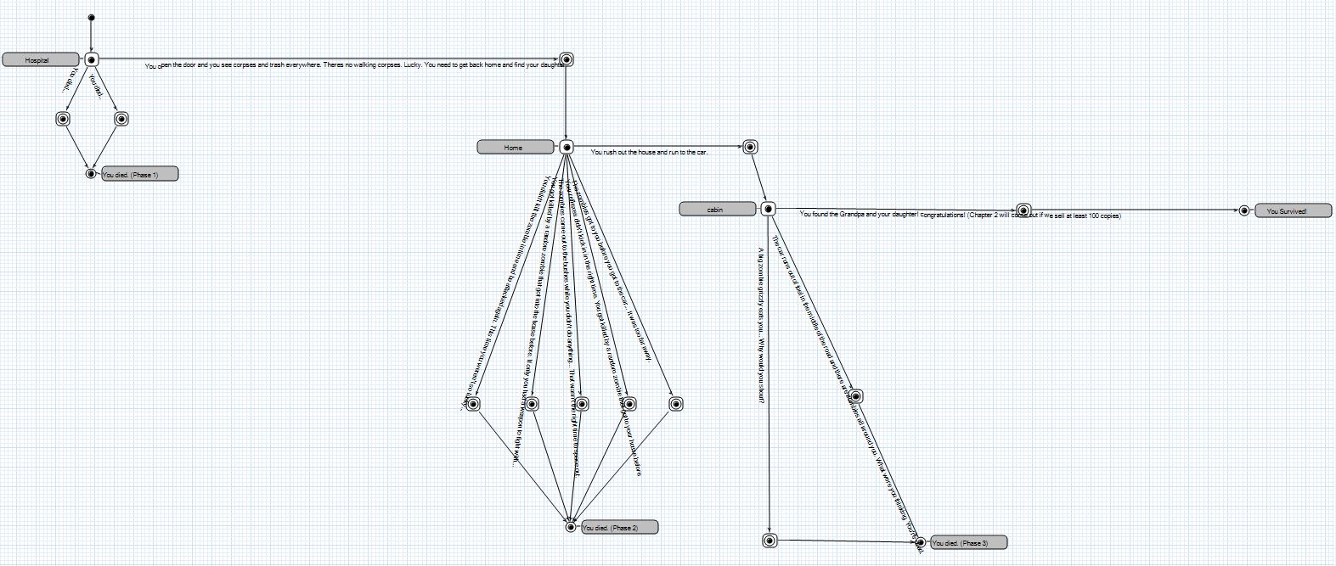

Slide 8
Personal recap
Our team has learned the fundamentals of game modelling through the development of the game.
Many challenges arouse in the development stage of the game such as the limitations of the Cinco adventure game tool.
It was difficult to get fair use images to use in our game. Many sites such as google images did not allow us to use their images as they were copyrighted.
As well as that, the Cinco game adventure tool was difficult to install on external computers. This slowed down the development process.

